Slide 1
VA Central IRB: IRBNet Refresher Training Angela Foster, VAIRRS Program Manager Don E. Workman, Ph.D., VA IRB Network Director Christie O’Brien, VA Central IRB Administrator Jessica Kroll, VA Central IRB Administrator Estela Hamblen, VA Central IRB Administrator October 7, 2021
Dial in (Main): (404) 397-1596
Attendee Access Code: 199-219-1720
Slides available on SharePoint:
See link in Q&A Box

Slide 2
Topics
What is VAIRRS?
Accessing and Registering in IRBNet
User Profile
My Projects
CIRB Submission Process
Viewing review results
Returned Packages
Unlocked Packages
Subsequent Packages
Live Demonstration

Slide 3
Important Process Changes
All new PI/SC and LSI study applications must be routed through the local research administration
In place of the previous 15-day waiting period for local context reviews
What is required from this Research Office Review
Depends on your local SOPs
We would recommend a review for local context input
All post-approval actions are to be submitted directly to the CIRB

Slide 4
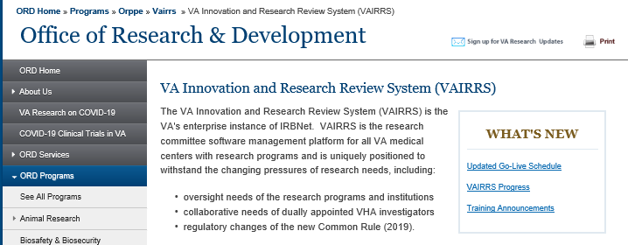
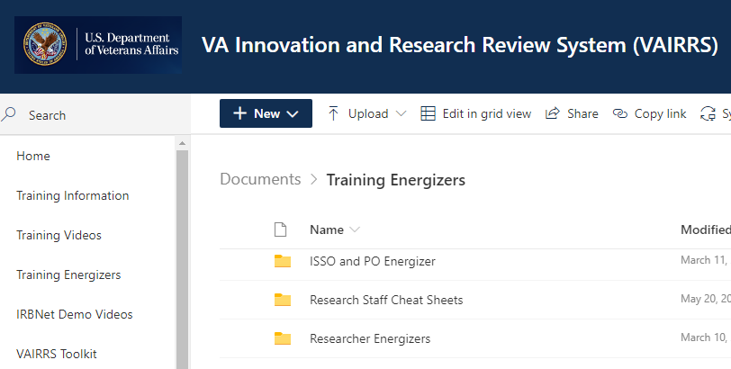
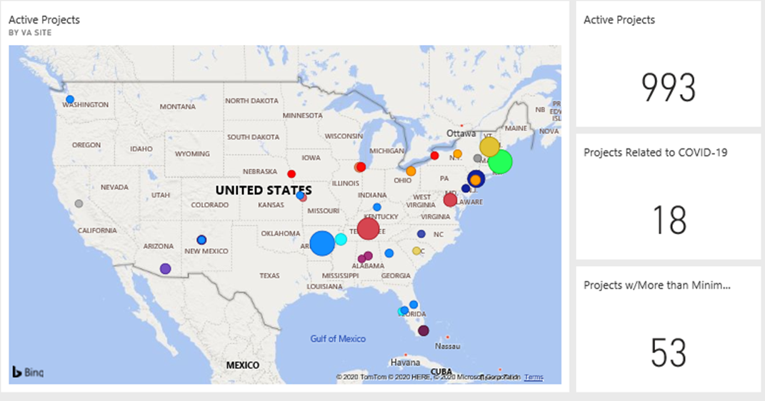
What is VAIRRS?
VA Innovation and Research Review System
IRBNet
VAIRRS Website: https://www.research.va.gov/programs/orppe/vairrs/default.cfm
VAIRRS SharePoint Portal: https://dvagov.sharepoint.com/sites/VHAORPPE/vairrs
Optimization Dashboards

Slide 5
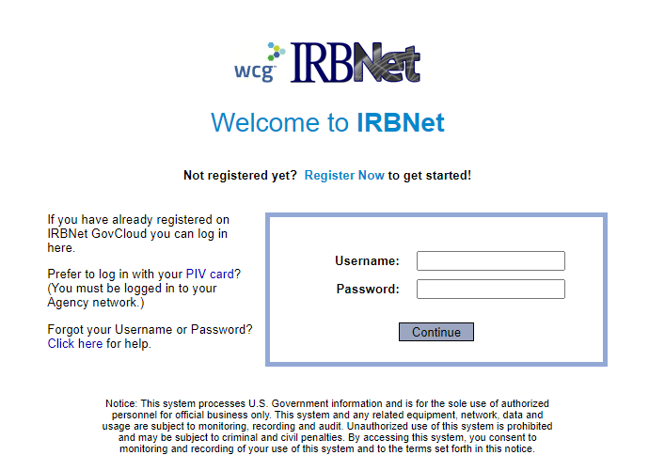
Accessing IRBNet
Website address: gov.irbnet.org
PIV Login
Accessible from outside the VA network

Slide 6
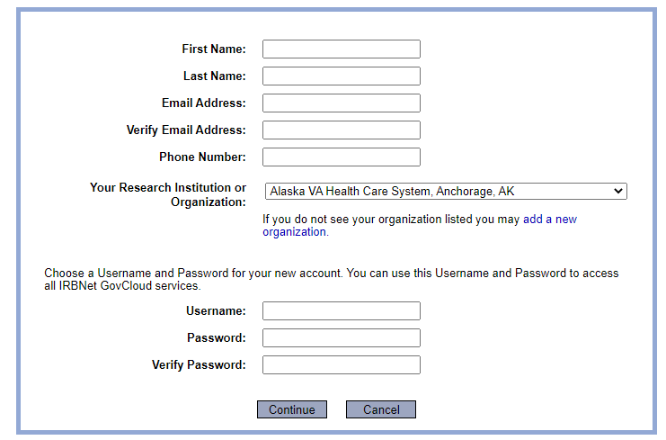
Enrolling in IRBNet
All VA facilities are listed in affiliation section

Slide 7
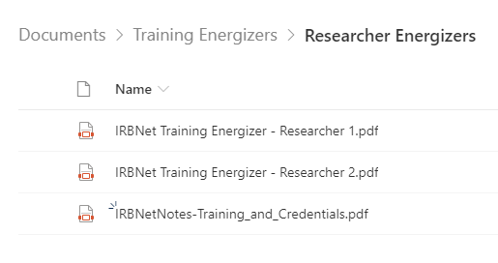
User Profile
Add additional affiliations
VAIRRS SharePoint Portal
-Training Energizers
-Researcher Energizers

Slide 8
IRBNet Terms
Institution/Organization – Each VAMC and the Central IRB are considered ‘Organizations’ in IRBNet
Workspace – Each Board or Panel at an Institution has a logical ‘workspace’ to manage submissions to that panel and conduct reviews
Package – Package and submission are used interchangeably. A package represents the individual submissions (Initial Review, CR, Amendments, etc.) for a project
Multiple Packages – Part of life in IRBNet
Submission Manager – The Submission Manager is the primary user interface for all user roles. The submissions viewable in your Submission Manager are dependent on your role, permission level, shared submissions, and selected (manual or default) filters
IRBNet ID – The IRBNet ID is the unique identifier for every Project and Package. The numbers before the dash represent the Project and the number after the dash represent the package

Slide 9
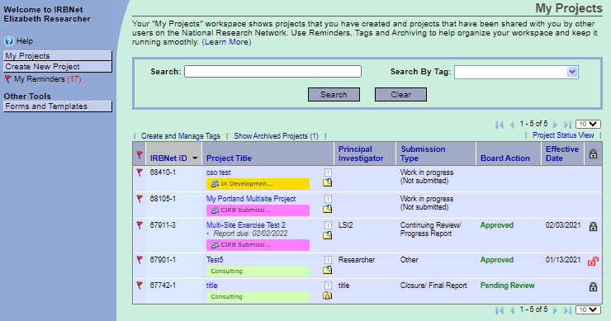
My Projects - Tags
Use Tags to organize your workspace

Slide 10
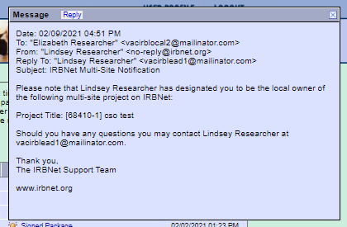
My Projects - Reminders
Reminders!

Slide 11
My Projects – Search Options
Search and Filter

Slide 12
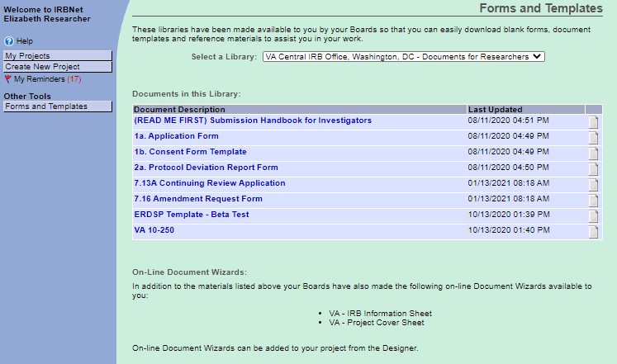
My Projects – Forms and Templates
Select the correct library!
Electronic Wizards

Slide 13
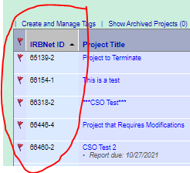
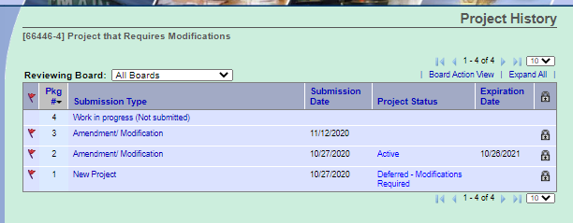
Project vs Package
Approved Project
(Package -1)
CR/Progress Report
(Package -3)
Amendment
(Package -4)
Amendment
(Package -2)
Unique
Identifier
Subsequent
Packages

Slide 14
Polls
Have you registered for an IRBNet account yet?
Yes
No
If you have registered, are you actively using IRBNet?
Not using at all
Using at least once a month
Using at least once a week
Using daily

Slide 15
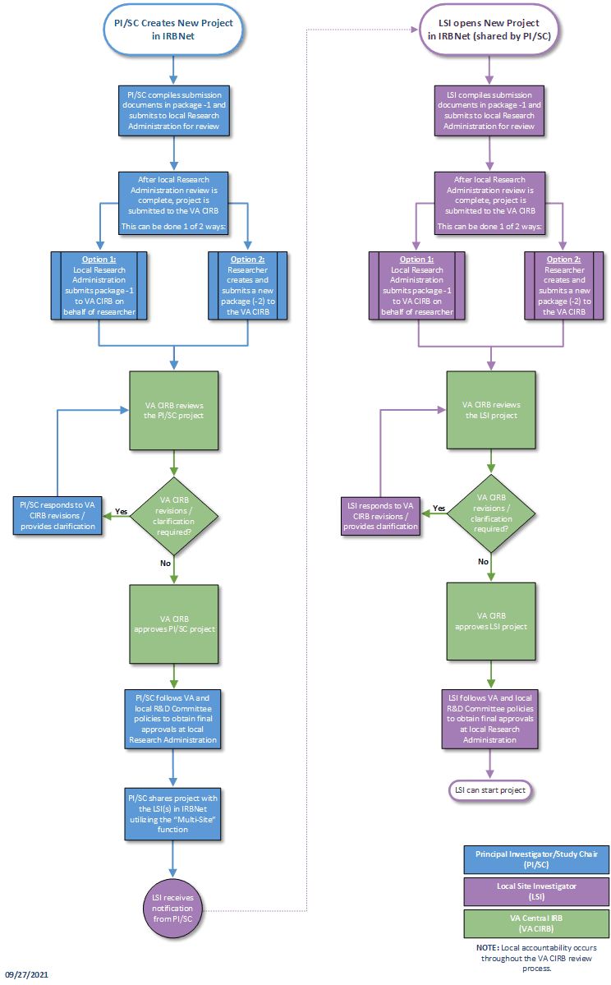
VA CIRB
PI/SC and LSI
New Project
Submission Process

Slide 16
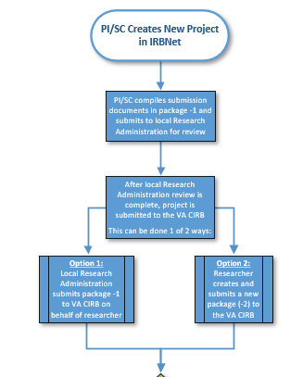
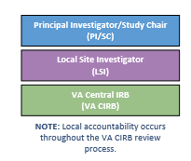

Slide 17
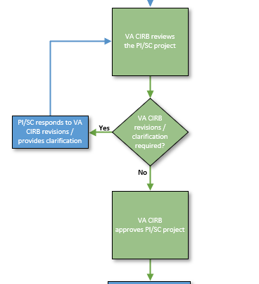

Slide 18
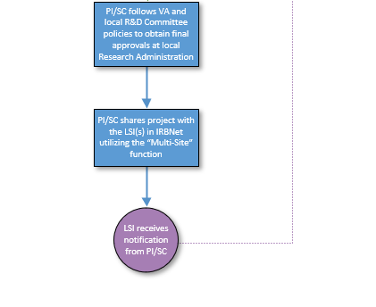

Slide 19
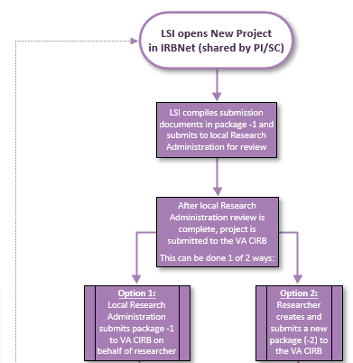

Slide 20
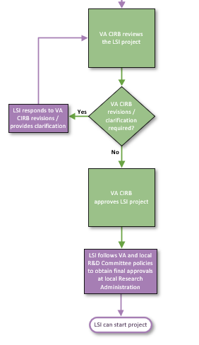

Slide 21
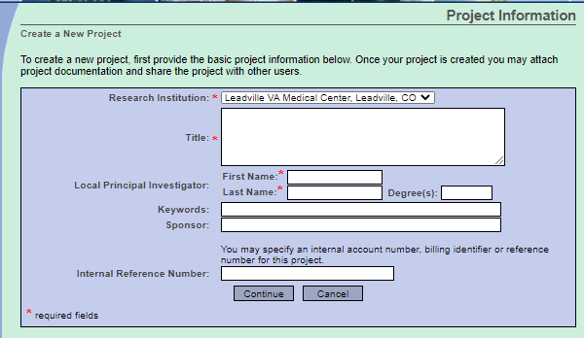
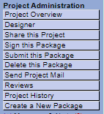
Creating a New Project or Package
Step 1: Select Create New Project or Create a new Package
Step 1
-OR-
Step 1

Slide 22
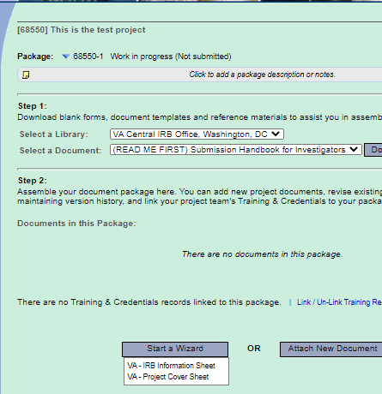
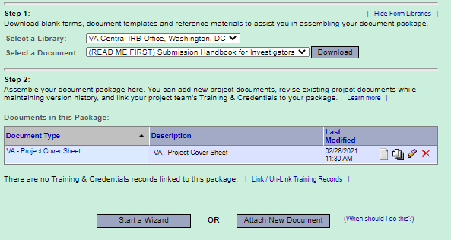
Creating a Project
Step 2: Complete electronic wizards
Step 2

Slide 23
Creating a Project
Step 3: Upload Study Documents
Step 3

Slide 24
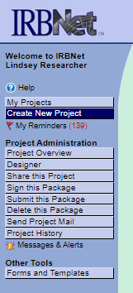
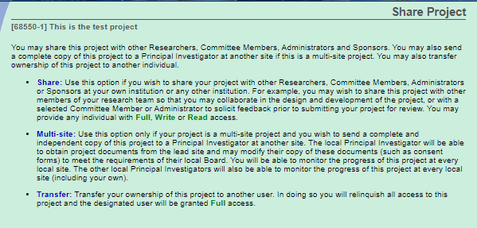
Creating a Project
Step 4: Share Package with study team
Step 4

Slide 25
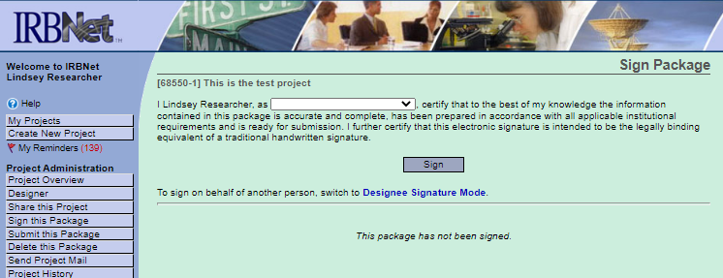
Creating a Project
Step 5: Sign Package
Step 5
VA Central IRB requires initial application be signed by PI or on behalf of the PI (prefer by the PI).

Slide 26
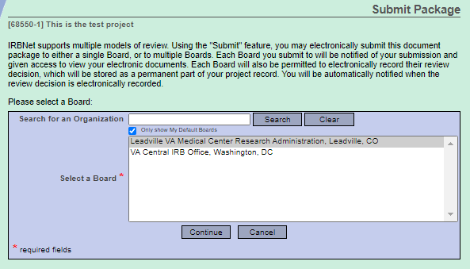
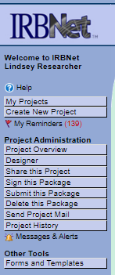
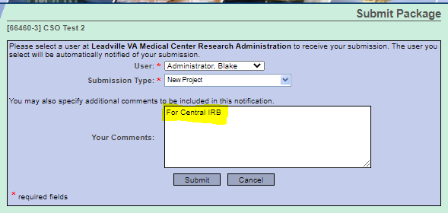
Creating a Project
Step 6: Submit Package to appropriate board
Step 6

Slide 27
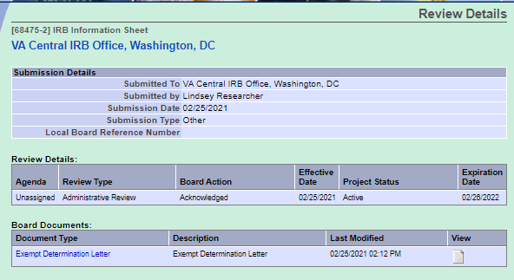
Review Results
Viewing review results

Slide 28
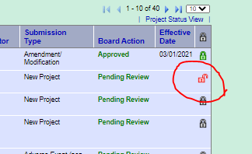
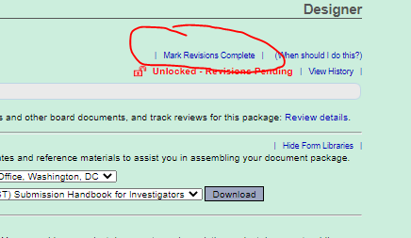
Returned Packages
All packages are ‘locked’ upon submission
Packages may be ‘unlocked’ and returned prior to board review if required forms are missing
Follow document upload instructions to add missing documents to package
Mark Revisions Complete

Slide 29
Subsequent Packages
Select ‘Create a New Package’
Repeat Steps 1 - 6

Slide 30
In Summary …
All new PI/SC and LSI study applications must be routed through the local research administration
All post-approval actions may be submitted directly to the CIRB

Slide 31
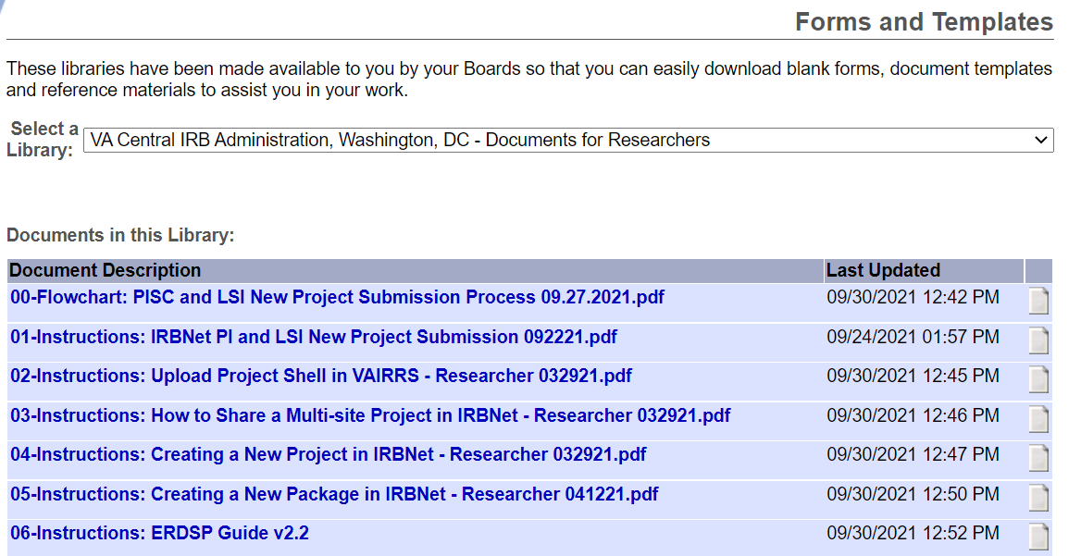
Additional Guidance
All guidance documents for the VA CIRB are posted in the Forms and Templates library

Slide 32
Additional Guidance
VAIRRS SharePoint Portal: https://dvagov.sharepoint.com/sites/VHAORPPE/VAIRRS
VAIRRS Website: https://www.research.va.gov/programs/orppe/vairrs/default.cfm
For questions regarding local submission procedures:
Contact your local research office
For questions related to CIRB processes:
Contact the IRB Manager
For questions related to the VAIRRS program:
Contact VAIRRS@va.gov
For technical issues with IRBNet:
Contact IRBNet Support at govsupport@irbnet.org

Slide 33
Thank You for Attending!

Slide 34
Questions?

Slide 35
Availability of Recording
A recording of this session and the associated handouts will be available on ORPP&E’s Education and Training website approximately one-week post-webinar
An archive of all ORPP&E-hosted webinars can be found here: https://www.research.va.gov/programs/orppe/education/webinars/archives.cfm

